Slide 1

Welcome to APIMASH!
<Presenter>
<Title>
Microsoft
<email>
<blog>

Slide 2
Agenda
APIMASH Intro
Session 1 – Starter Kits and Calling APIs
Session 2 – Creating Your Windows Store App
Hands-On: Workbook #1 - Getting Started
Hands-On: Workbook #2 - Customizing Your UI
Hands-On: Workbook #3 - Getting Store-Ready
Closing Comments & Demos!

Slide 3
Why APIMASH?
There’s data out there!
Free data & services from APIs
Starter Kits will make things easier
We’ll help you along the way and…
You’ll be Windows Store app publisher!

Slide 4
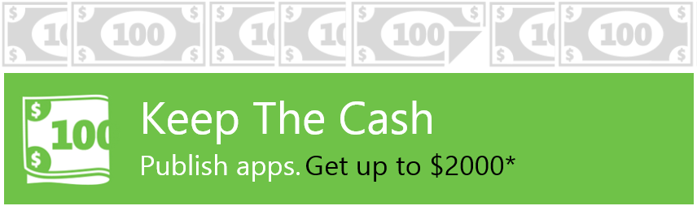
After APIMASH…
Other Workshops
Check with your local evangelist
Office Hours
Help with your questions & issues
Use the “Keep the Cash” offer!
build.windowsstore.com/keepthecash
$100 per app in Windows Store & Windows Phone Store
Up to 10 per developer, per store
Now through June 30, 2013

Slide 5
Kevin Ashley…
(Brian Hitney to provide slide)

Slide 6
APIMASH Session 1 – Starter Kits & APIs

Slide 7
Agenda: Session 1
Third-Party APIs
The Starter Kits
Starter Kit Architecture
Calling APIs

Slide 8

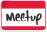




The World of APIs
API = Application Programming Interface
Thousands are available
http://www.apihub.com (lists 13,000+)
We identified some that:
Support free use
Reasonable throttling of requests
Return easy-to-use data (as JSON or XML)

Slide 9

demo
APIs – What’s out there?

Slide 10

A Mashup?
Feeling creative? Consider a true Mashup!
Mashups combine two or more APIs in a way that:
Shows data in a new way
Provides a new experience or,
Supports a specific scenario
Start with one Starter Kit, then fold the data model in from another
Food, Social, Gaming, Mapping, Government…
Endless possibilities

Slide 11
The Starter Kits

Slide 12
The Starter Kits
Your Starting Point
Visual Studio 2012 Projects
Some in XAML/C#, some in HTML5/JS
Customizable by you
Each Kit:
Calls a target API
Serializes & deserializes API data
Exposes data a via bindable object model
Data binds those objects to UI controls

Slide 13

Active Access Starter Kit
HTML/JavaScript
Finds activities by calling Active Access API api.amp.active.com
More at developer.active.com

Slide 14
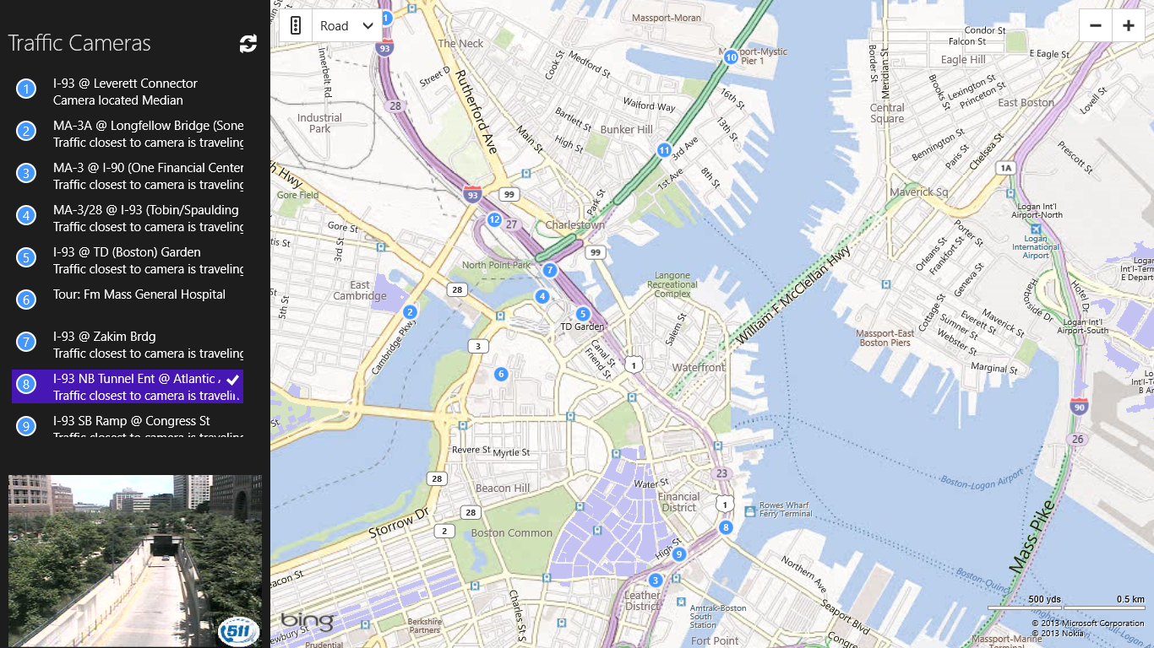
Bing Maps / TomTom Starter Kit
XAML/C#
Mashup of BingMaps with TomTom’s Traffic Cams API

Slide 15
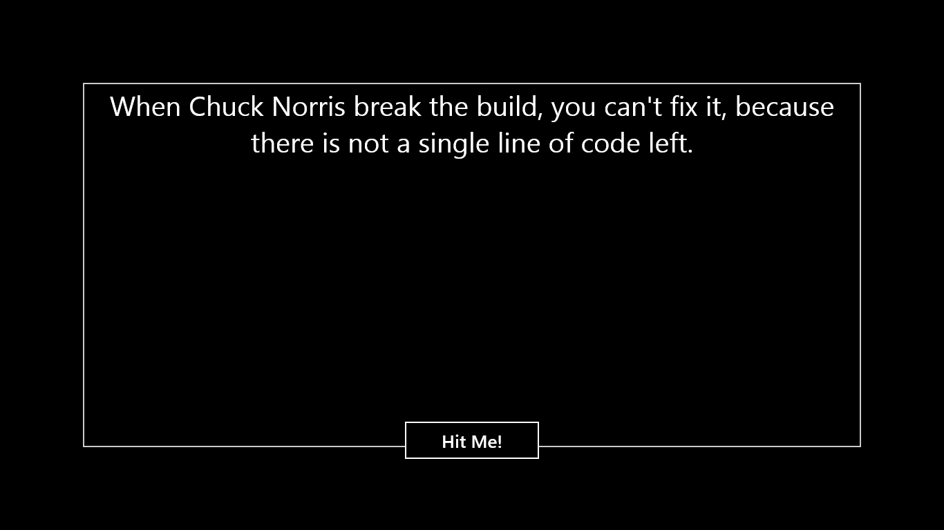
Chuck Norris Starter Kit
XAML/C#
Uses the Internet Chuck Norris Database API
www.icndb.com

Slide 16
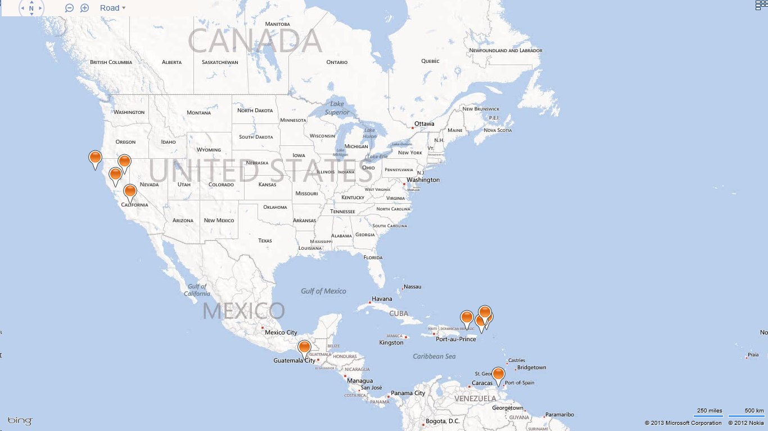
Earthquakes Starter Kit
HTML/JavaScript
Loads earthquake data from the USGS
Displays a pushpin per earthquake on Bing maps

Slide 17
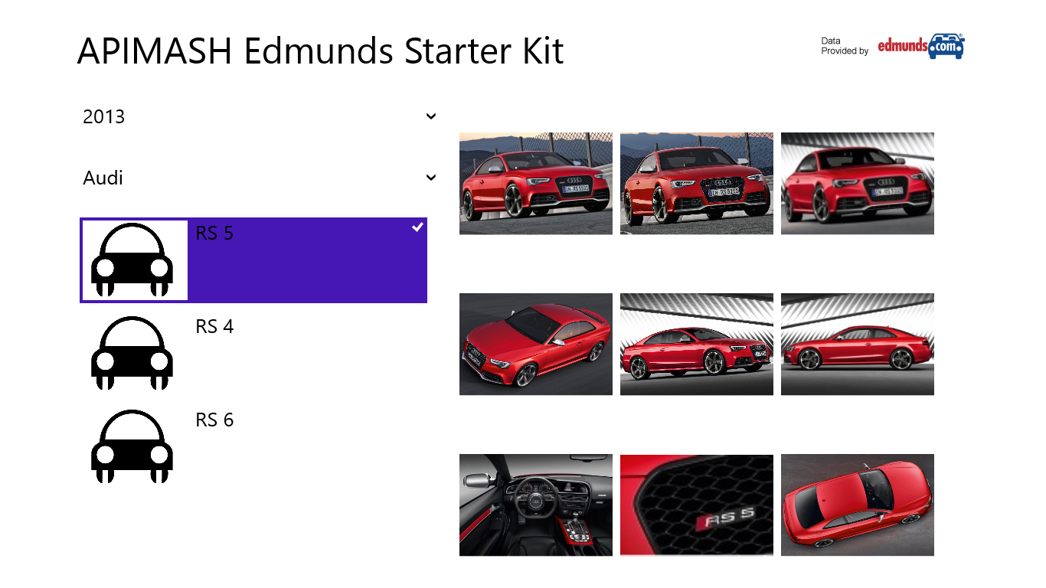
Edmunds Starter Kit
XAML/C#
Based on the Blank VS template
Invokes the Edmunds REST API developer.edmunds.com

Slide 18
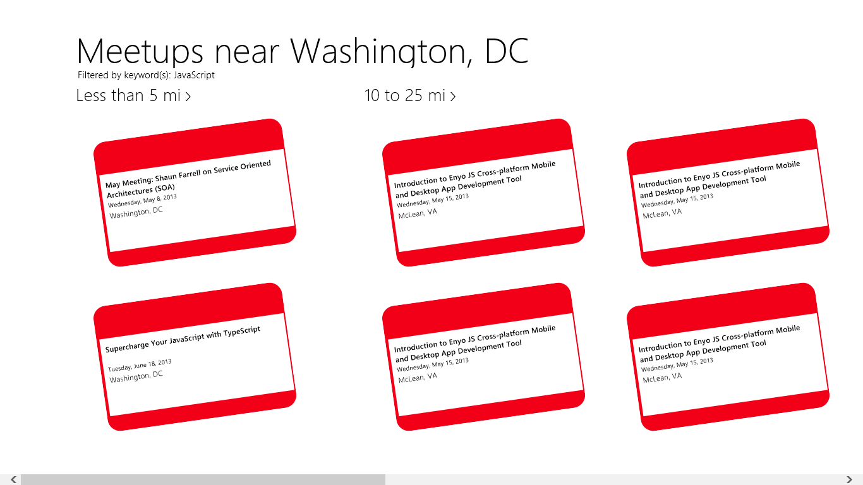
Meetup / Bing Maps Starter Kit
HTML/JavaScript
Based on the Grid VS template
Uses Meetup.com API for upcoming meetups near a given location
Queries the Bing Maps Search API for coffee near meetup

Slide 19
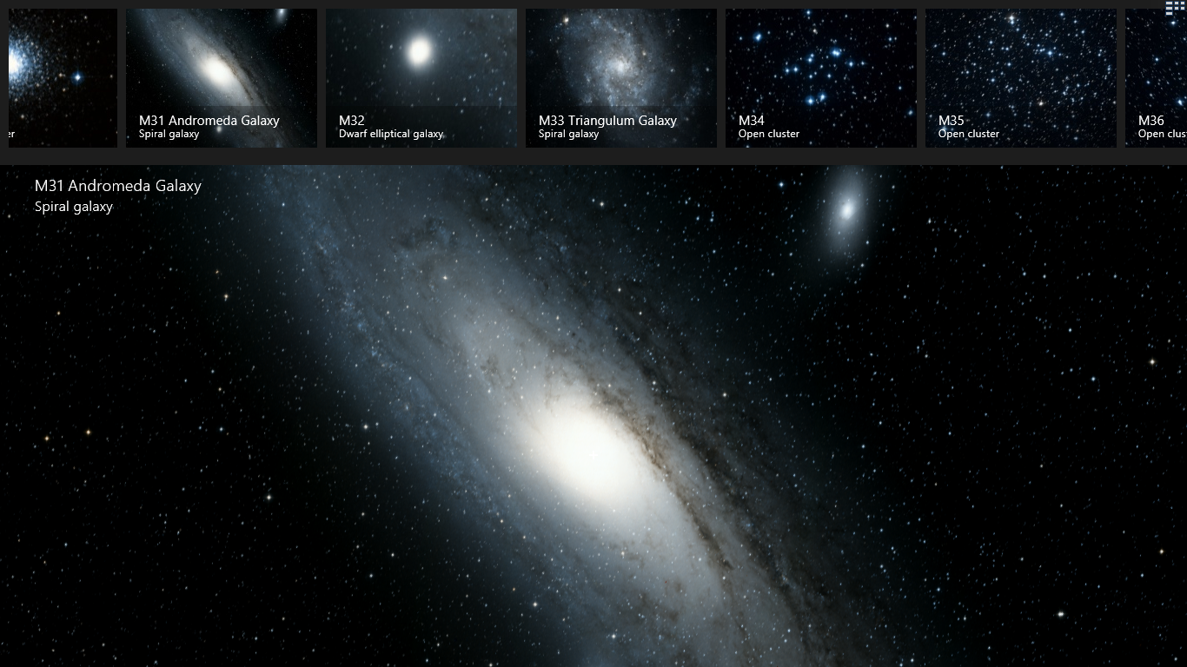
Messier Sky Objects Starter Kit
HTML/JavaScript
Uses the Worldwide Telescope HTML JavaScript SDK
Collection of sky objects (called the Messier Catalog) is bound to a list, and allows the user to explorer these objects in the sky

Slide 20
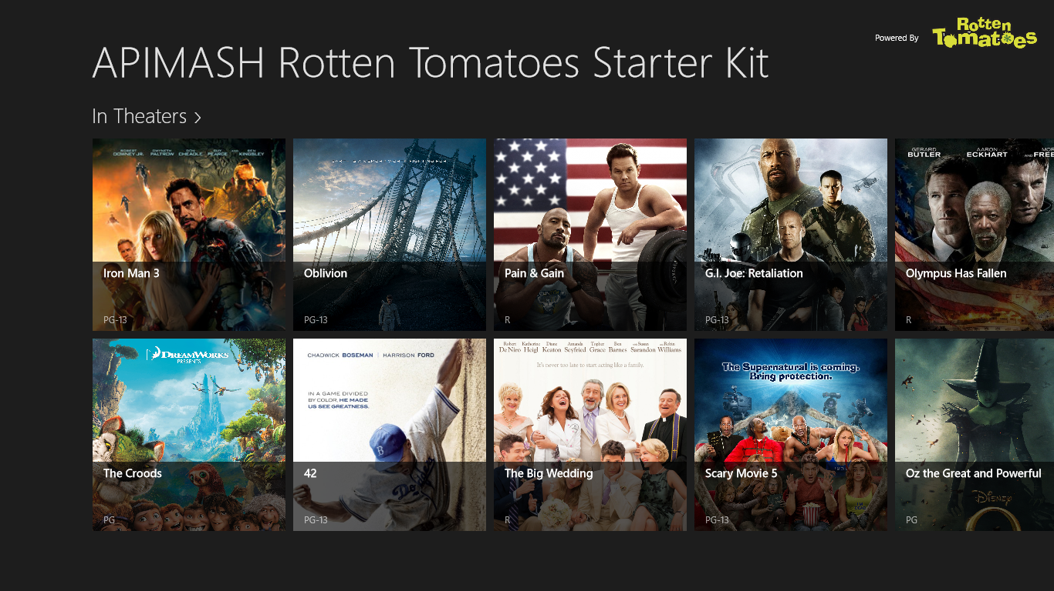
Rotten Tomatoes Starter Kit
XAML/C#
Based on the Grid VS template
Calls Rotten Tomatoes REST API for movies developer.rottentomatoes.com

Slide 21
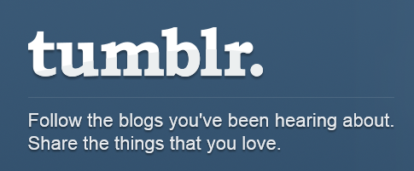
Tumblr Starter Kit
HTML/JavaScript
Calls Tumblr API www.tumblr.com
Accesses tags
Downloads images

Slide 22
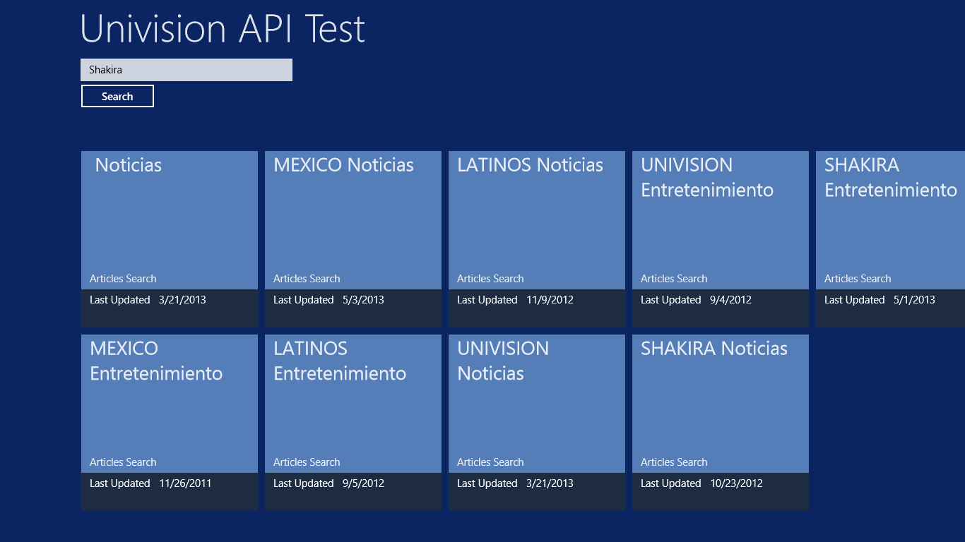
Univision Starter Kit
XAML/C#
Calls Internet Univision API developer.univision.com
Shows how to add XML feeds to C#

Slide 23
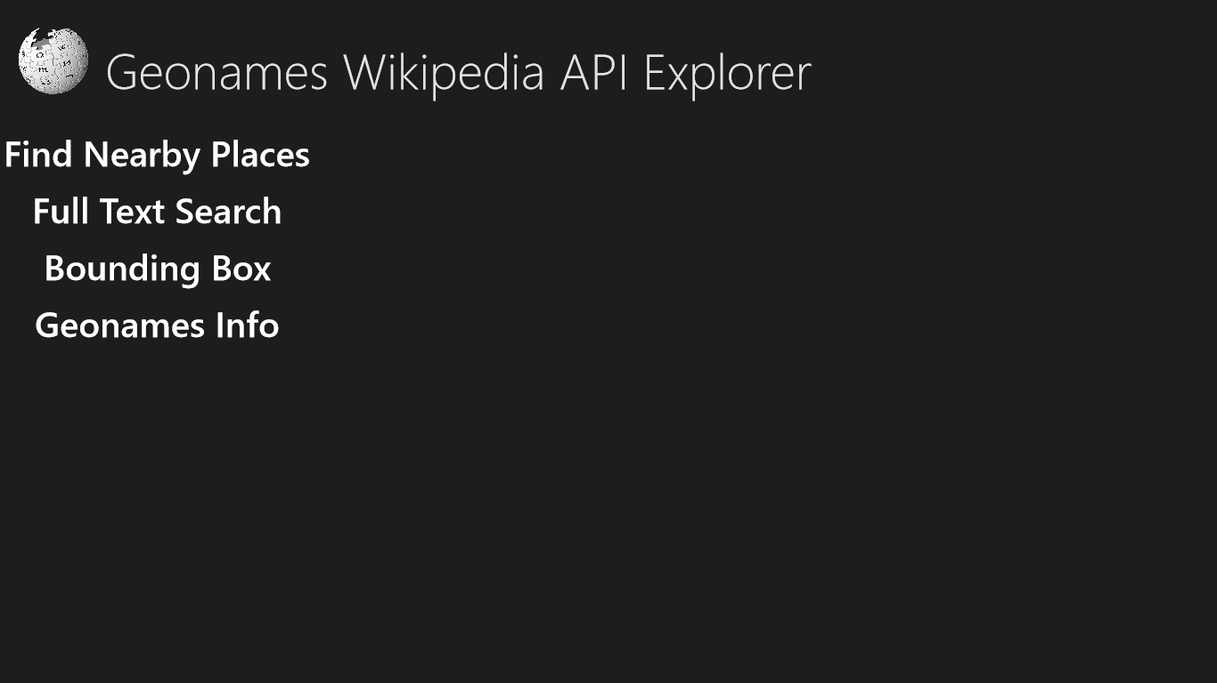
Wikipedia Starter Kit
XAML/C#
Calls Wikipedia search via GeoNames API api.geonames.org

Slide 24
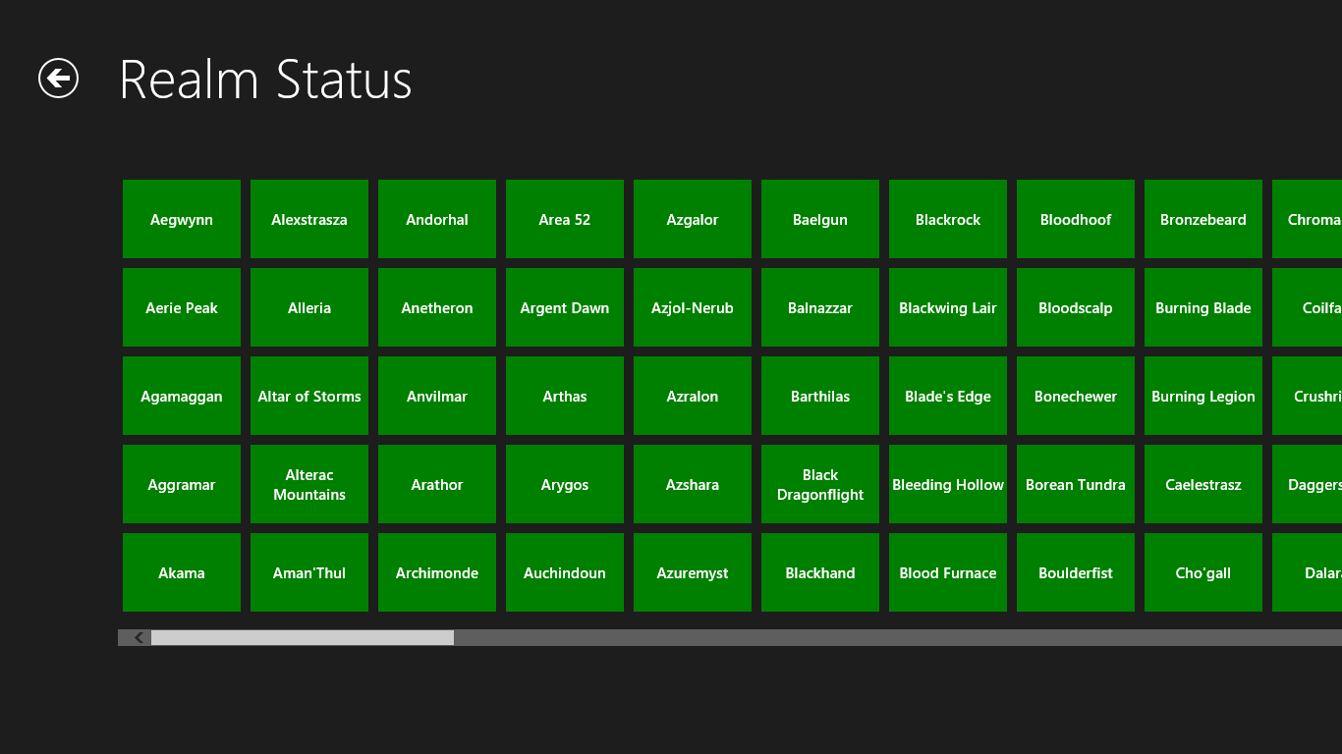
World of Warcraft Starter Kit
HTML/JavaScript
Shows WoW realm/server status
Calls WoW API blizzard.github.io/ api-wow-docs

Slide 25
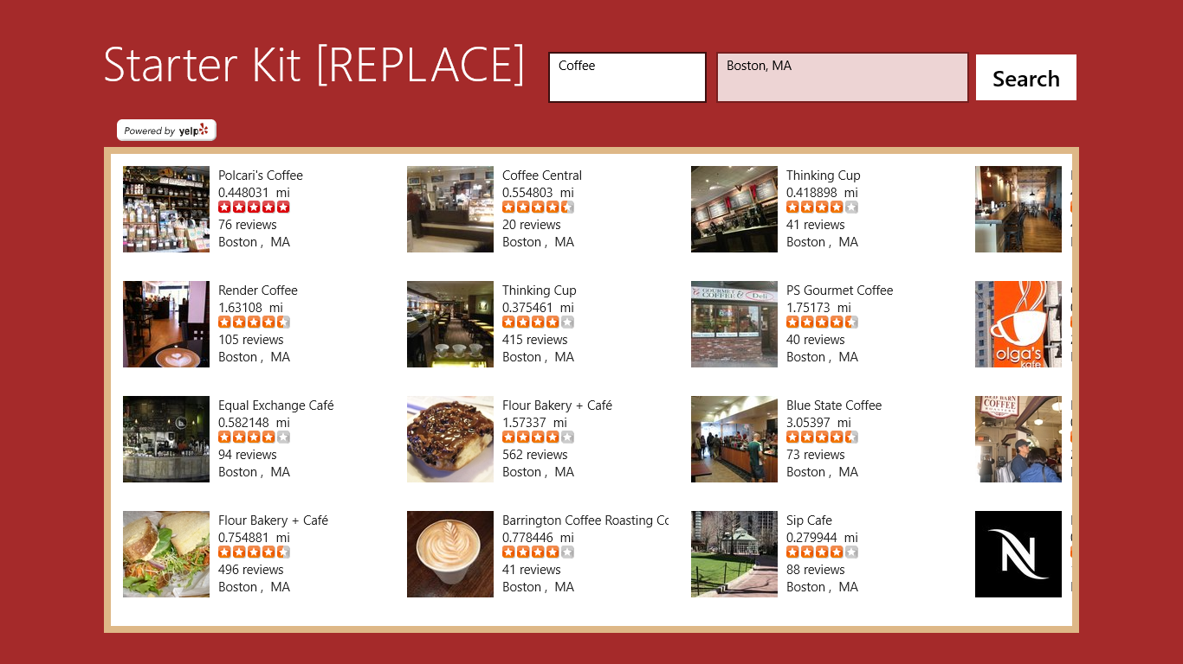
Yelp Starter Kit
XAML/C#
Shows nearby businesses given a location
Calls Yelp API api.yelp.com/ business_review_search
Register for API at www.yelp.com/developers

Slide 26
Starter Kit Architecture

Slide 27
APIMASH Starter Kit Sequence Diagram
Client App
Web Service API
1. Call
Invoke API
Async
API Returns JSON Payload
2. Async Callback
Deserialize JSON to Data Model
3. Copy
Copy to Bindable View Model
4. Display
Bind to UI Control

Slide 28
demo
A Starter Kit in Action

Slide 29
Starter Kit Architecture
Class library that provides the models for mapping from the API and for mapping from that model to a bindable model
Starter Kit
A
C
Windows 8 App Boilerplate
APIMASH_[APIName]Lib
The cloud
Some API
B
APIMASHLib
Provides a minimal starting point for binding data to controls and Windows 8 features
Library of reusable code for invoking APIs, authentication, and mapping to models

Slide 30
demo
Starter Kit, Behind the Scenes

Slide 31
APIMASH Session 2 – Your Windows Store App

Slide 32
Agenda
Windows 8 User Experience
Introduction to Common Controls
Presenting Data
Understanding Data Binding

Slide 33
User Experience

Slide 34
Traits of a great Windows Store App
Leverage Microsoft design
Be Fast and fluid
Snap and scale beautifully
Use the right contracts
Invest in a great Tile
Feel connected and alive
Roam to the cloud
Embrace Microsoft design principles

Slide 35
Controls

Slide 36

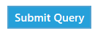
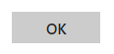

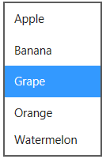
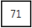
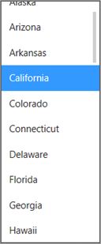
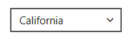
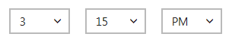

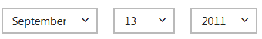
Everyday widgets
Button
Hyperlink
Ratings*
ListBox
Checkbox
Slider
Combo Box
Progress Bar
Time Picker*
Progress Ring
Date Picker*
Toggle Switch
Radio Button
* Not in XAML built-in controls set, available via 3rd party

Slide 37

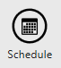
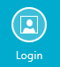
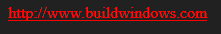

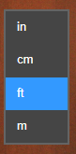

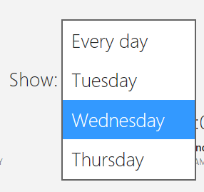

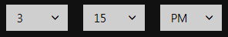

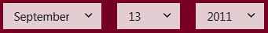
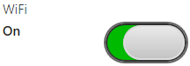
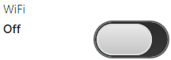

Everyday widgets - custom styled
Button
Hyperlink
Ratings
ListBox
Checkbox
Slider
Combo Box
Progress Bar
Time Picker
Progress Ring
Date Picker
Toggle Switch
Radio Button

Slide 38
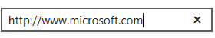
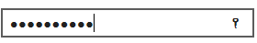
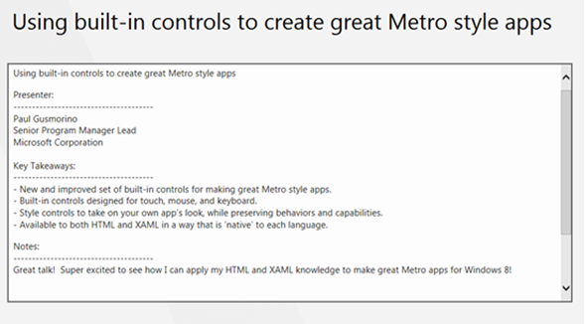
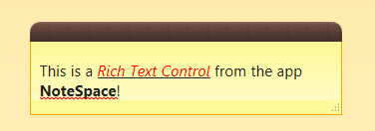
Text editing controls
Single-Line Text Box
Password
Clear Button
Reveal Button
Multi-Line Text Box
Rich Text Box

Slide 39
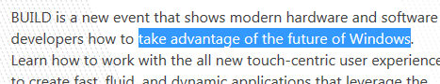
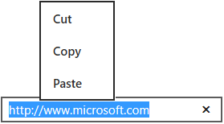
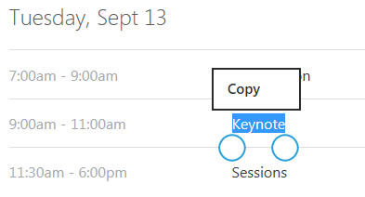
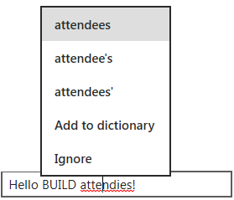
Text editing controls - behaviors
Text Selection : Mouse and Keyboard
Cut, Copy, and Pate
Touch
Spellchecking

Slide 40
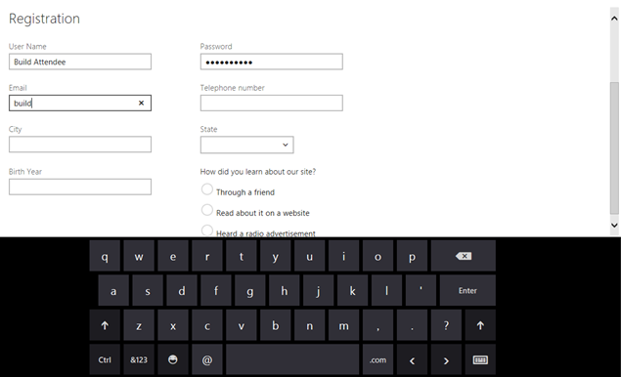
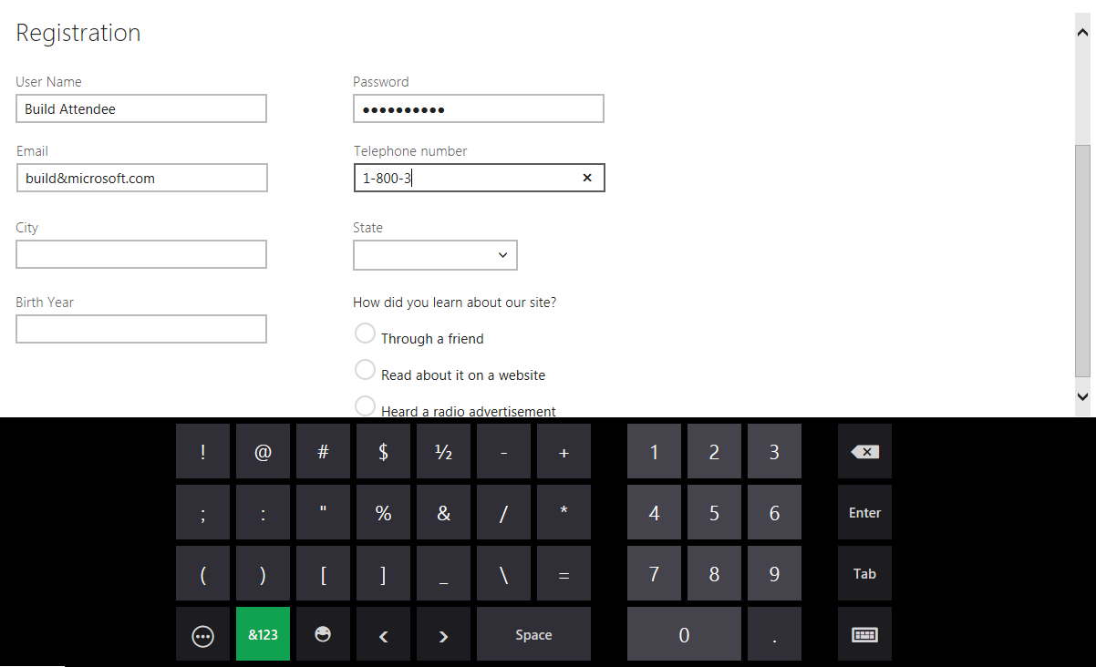
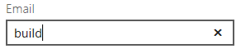
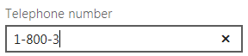
Text editing controls - touch keyboard

Slide 41
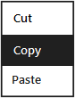
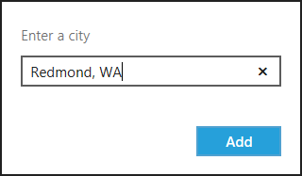
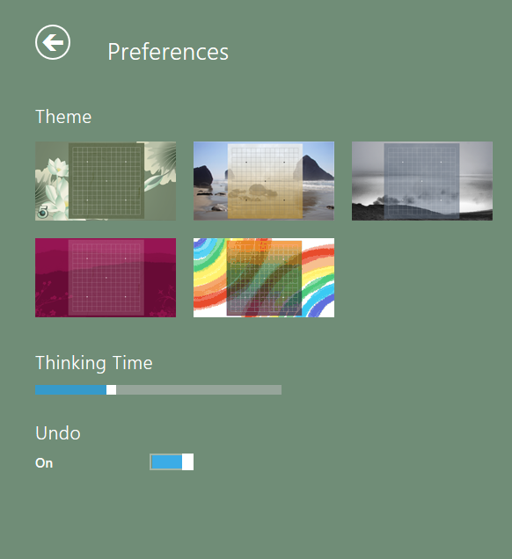
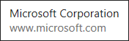
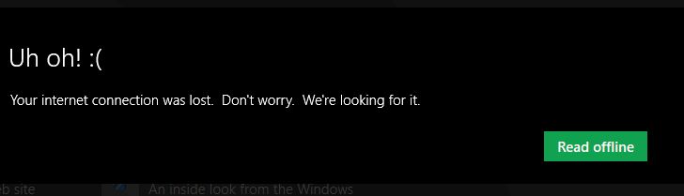
Commanding surfaces
App Bar
Context Menu
Flyout*
Settings Pane*
Tooltip
Message Dialog
* Not in XAML built-in controls set, available via 3rd party

Slide 42
Presenting Data

Slide 43
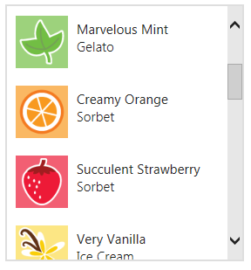
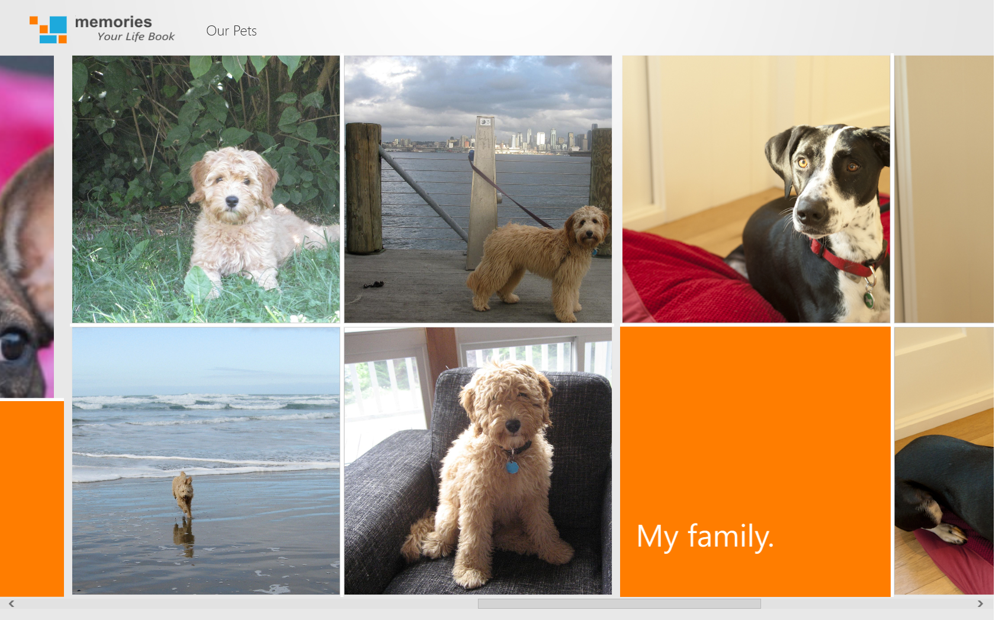

Presenting data
List View
Grid View
Flip View

Slide 44


Semantic zoom

Slide 45


Building for snap and portrait
Snap
Portrait

Slide 46
Data Binding

Slide 47
Data Binding Overview
Each data binding has three parts:
Binding source: an object with data that you want to present (this is the View Model)
Binding target: a DependencyProperty of a FrameworkElement
Binding object: synchronizes data between the source and target, possibly reformatting it with a value converter

Slide 48
Data Binding Architecture
Binding Source (DependecyProperty / INotifyPropertyChanged)
Data Updates (one-way)
Binding Object
Data Updates (one-way)
Binding Target
(Property)
Data Updates (two-way)
Data Updates (two-way)
Binding engine gets information from the Binding object:
Source and target objects
Direction of the data flow (Binding.Mode property)
Optionally, a value converter (Converter property)
Instance of a class that implements IValueConverter

Slide 49
Data Binding
Two ways in XAML to define the source object for a data binding:
DataContext property
Must bind to a type that implements INotifyPropertyChanged
Sets the bindings for that element and all child elements
ItemsSource property of a List control
Must bind to a type that implements INotifyCollectionChanged
ObservableCollection is a built-in class that implements this
Items contained by the collection must implement INotifyPropertyChanged

Slide 50
Dependency Property, Dependency Object
A DependencyProperty is a special type of property
Can be data bound
Tracked by XAML Binding Engine
For binding to work, the object with the dependency property must be a subclass of DependencyObject
FrameworkElement is a subclass of DependencyObject, so all controls can participate in data binding
<TextBlock x:Name="DescriptionTextBlock" Margin="12,0,0,0" Text="{Binding Description} " />
Dependency Object
Dependency Property
Binding Markup Extension

Slide 51
Data Binding with Lists
You Can also bind to lists in two ways:
Extend ObservableCollection<T>
Implement IList and INotifyCollectionChanged
collection items must implement INotifyPropertyChanged
In the ItemsPanel of the XAML list element, you are bound to the individual item of the collection

Slide 52


How to get started with GridView (XAML)
GridView =
ItemsSource
+ ItemTemplate
+ ItemsPanel
Data
ItemContainerStyle

Slide 53
GridView data templating (XAML)
<DataTemplate x:Key="StoreFrontTileTemplate">
<StackPanel Orientation="Horizontal" Margin="10,10,0,0">
<Image Source="{Binding Image}" Height="60" Width="60" VerticalAlignment="Center" Margin="0,0,10,0"/>
<TextBlock TextWrapping="Wrap" Style="{StaticResource ItemTitleStyle}" Width="200“ />
</StackPanel>
</DataTemplate>
<Style x:Key="StoreFrontTileStyle" TargetType="GridViewItem">
<Setter Property="FontFamily" Value="Segoe UI" />
<Setter Property="Foreground" Value="White" />
<Setter Property="Height" Value="80" />
<Setter Property="Width" Value="292" />
<Setter Property="TabNavigation" Value="Local" />
</Style>
<Grid Height="300" VerticalAlignment="Top">
<GridView x:Name="ItemGridView" Background="White"
ItemTemplate="{StaticResource StoreFrontTileTemplate}"
ItemContainerStyle="{StaticResource StoreFrontTileStyle}"
BorderBrush="LightGray"/>
</Grid>

Slide 54
demo
Data Binding

Slide 55

Contracts

Slide 56
Why you should care about Contracts
They enable your app to “light up” scenarios that delight users by allowing them to use your app with another app or device
Some of them drives users back to your app from other parts of the system, while others simply save you from providing entry points for common scenarios
They allow you to focus on the part of the scenarios that you’re best at – the unique parts of the user experience – and the system provides the rest

Slide 57
Types of Contracts
Search
Share
Settings
Play To
App-to-App Picking

Slide 58
APIMASH Time to Code!
Hands-On: Workbook #1 - Getting Started
Hands-On: Workbook #2 - Customizing Your UI
Hands-On: Workbook #3 - Getting Store-Ready
Closing Comments & Demos!

Slide 59
Hands-on Activity #1 (Use workbook #1)
Choose Your API and Starter Kit - apimash.github.io/StarterKits (URL is case sensitive)
Read the Kit’s Readme.md file (no, really!)
Register to receive an API key – e.g. www.yelp.com/developers
Add your API key to the project file
Explore and understand your Starter Kit
Update the API call as you wish (e.g. for a specific city)

Slide 60
Hands-on Activity #2 (Use workbook #2)
Change your app’s functionality as you’d like
If needed, update data model to capture new data from the API
Update Your app’s UI with new controls & layout
If needed, update view model to expose new data
Bind your view model to controls as needed
Update the name, title, etc. of the app

Slide 61
Hands-on Activity #3 (Use workbook #3)
Create an app definition on your dashboard - dev.windows.com
Associate the app with the Store
Update the logos & splashscreen
Update the About, Support, and Privacy Policy links
Create a set of screenshots (Tip: Use the Simulator in Visual Studio)
Build & upload the app package
Test - Directly and w/Windows App Certification Toolkit (WACK)
Complete the app submission!

Slide 62
Resources
APIMASH Home
apimash.github.io/StarterKits
Windows Developer Home, Accounts, Resources
dev.windows.com
Windows Developer Training
channel9.msdn.com/Events/Developer-Movement
Windows Design Resources
design.windows.com
UX Fundamentals Training
channel9.msdn.com/Events/Windows-Camp/ Windows-8-UX-Fundamentals-Training-Workshop-2012

Slide 64
Windows 8 Platform
Windows Store Apps
Desktop Apps
View
XAML
HTML / CSS
HTML
JavaScript
Model Controller
C
C++
C#
VB
JavaScript
(Chakra)
C
C++
C#
VB
WinRT APIs
System Services
Communication
& Data
Graphics & Media
Devices & Printing
Application Model
Internet Explorer
Win32
.NET / SL
Core
Windows Core OS Services

Slide 65

How to get started with ListView (HTML)
ListView =
dataSource
+ itemRenderer
+ layout
Data
CSS
WinJS.UI.GridLayout

